Slide 1
Seed germination
Derek M^{c}Creery
Christian Katsabas

Slide 2
Proposal
The aim of this project was to create a monitoring station to measure and record the environmental conditions of the greenhouse here at Humber. The station will have the equipment to measure soil conditions of the plants and provide water to them as necessary.

Slide 3
Budget
Arduino - $28.99
Raspberry Pi starter kit - $89.95
USB cable - $3.95
Sensors - $24.33
Watering Pump - $24.95
Power adapter - $6.95
MOSFETs - $1.65
Keyboard - $30.00
Total Before Tax and Shipping: $210.77

Slide 4
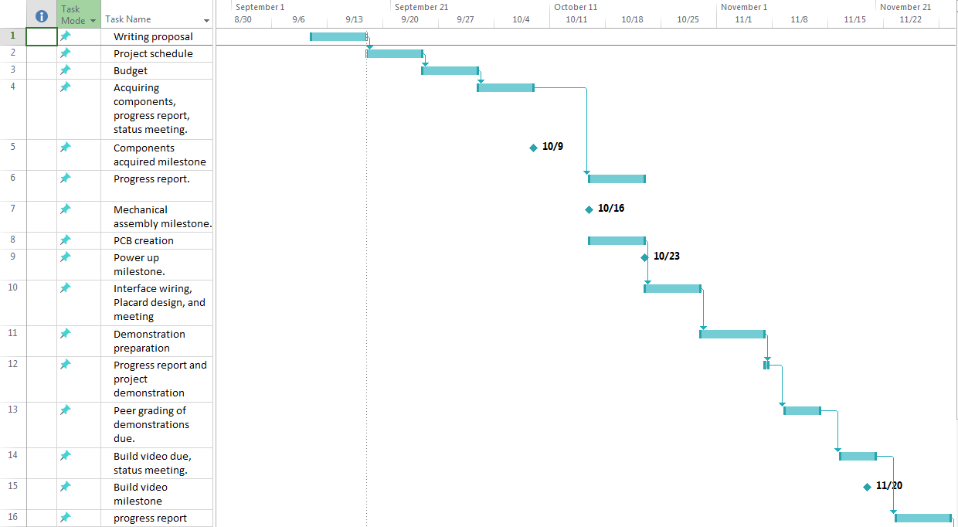
Schedule

Slide 5
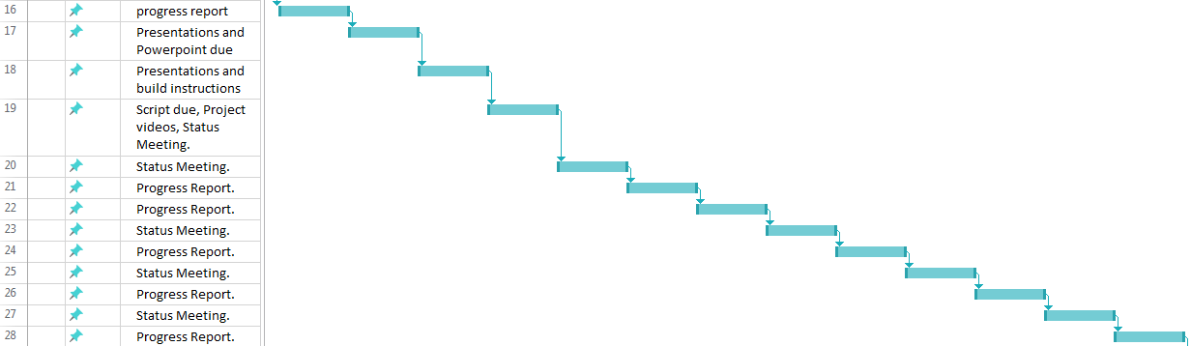

Slide 6
Related Courses
CENG 200 UNIX Scripting
CENG 212 Programming Techniques in Java
CENG 252 Embedded Systems
CENG 256 Internet Programming
CENG 317 Hardware Production Technology
CENG 319 Software Project
CENG 320 Network Programming

Slide 7
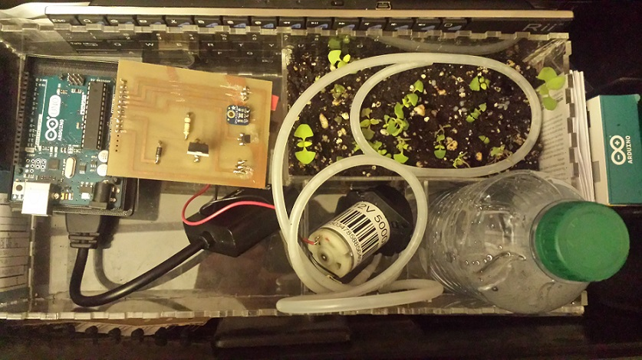
The Hardware

Slide 8
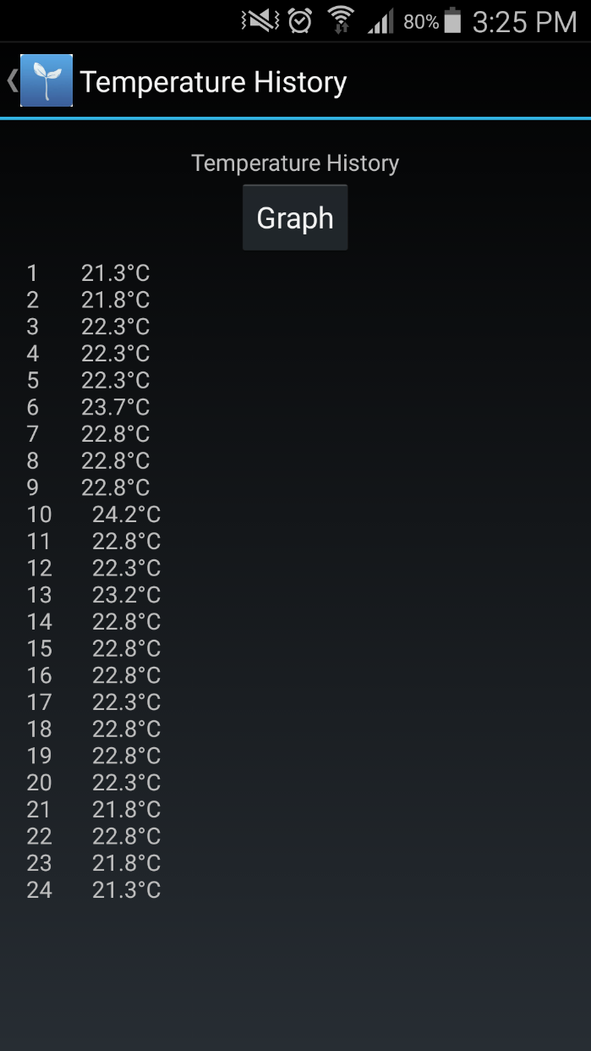
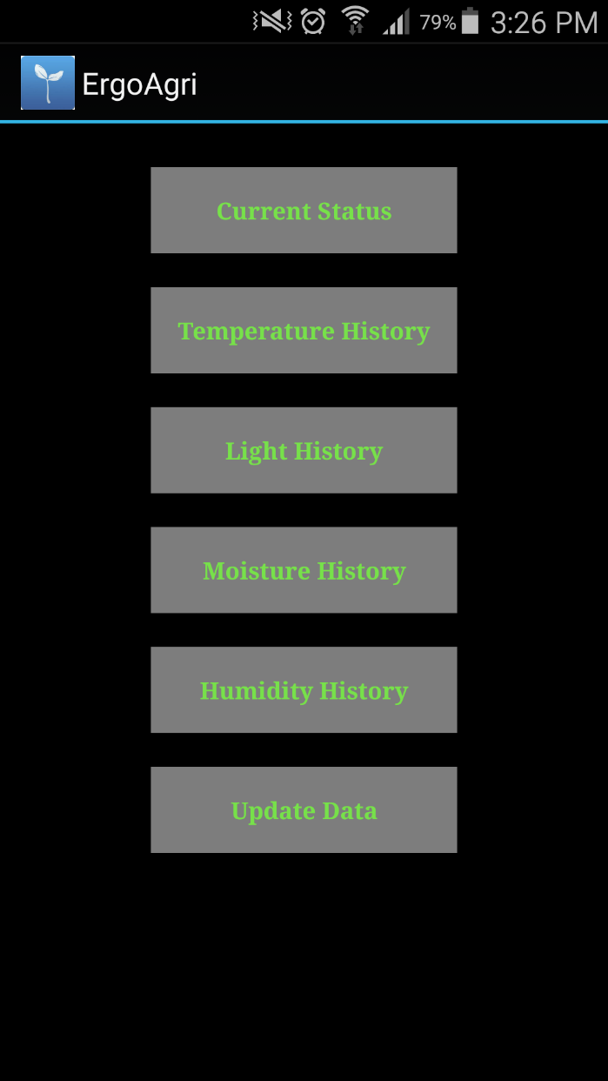
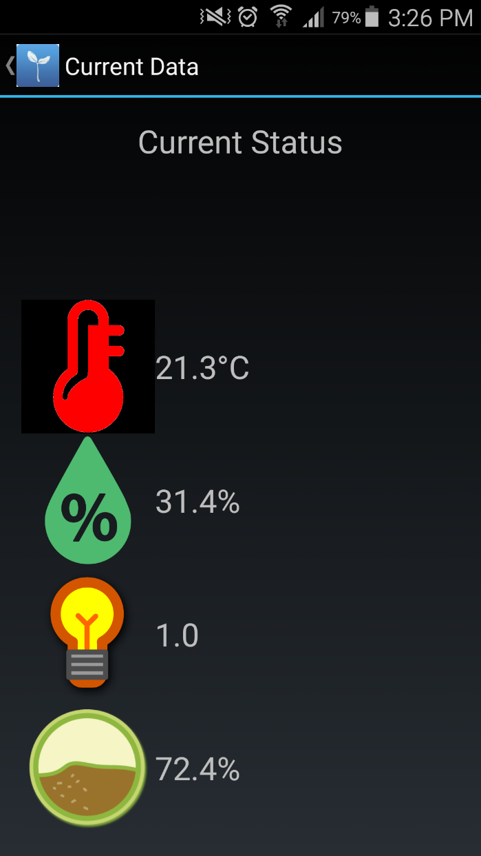
The Mobile Application

Slide 9
